Slide 1
Modeling COVID-19 in Taiwan
資工三 林靖紳

Slide 2
Table of Content
Program Architecture
Get Data
Training Model
Visualize
Conclusion

Slide 3
Program Architecture

Slide 4
Get data
(.csv)
Initial Variables
(Set configparser)
Define Training model
(Linear regression)
Model Predictions
(Call model and forecast)
Visualize
(Plot results and estimate relative error)

Slide 5
Get Data

Slide 6
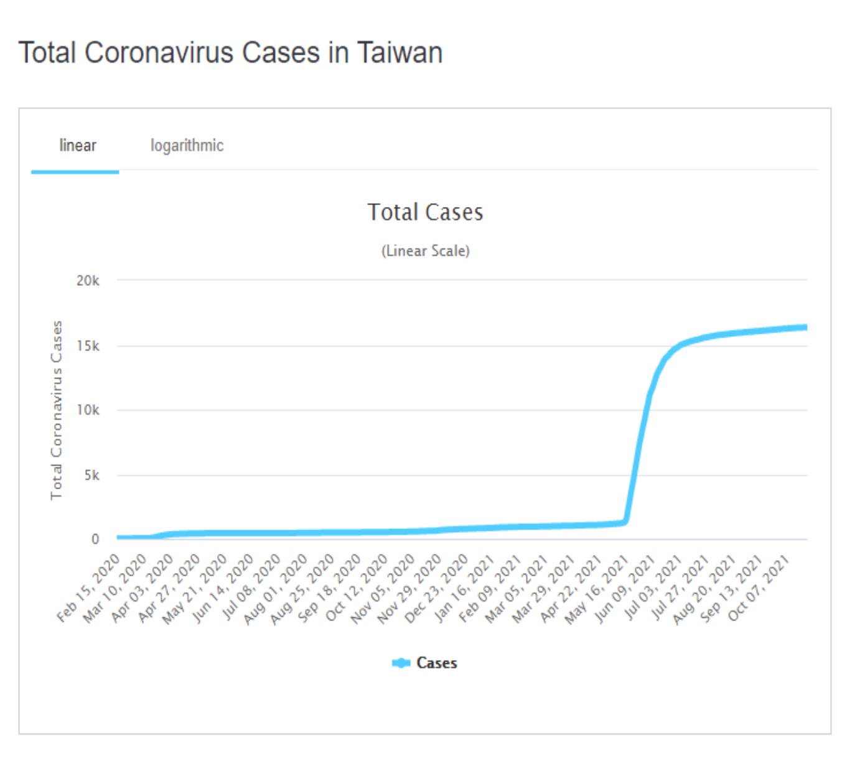
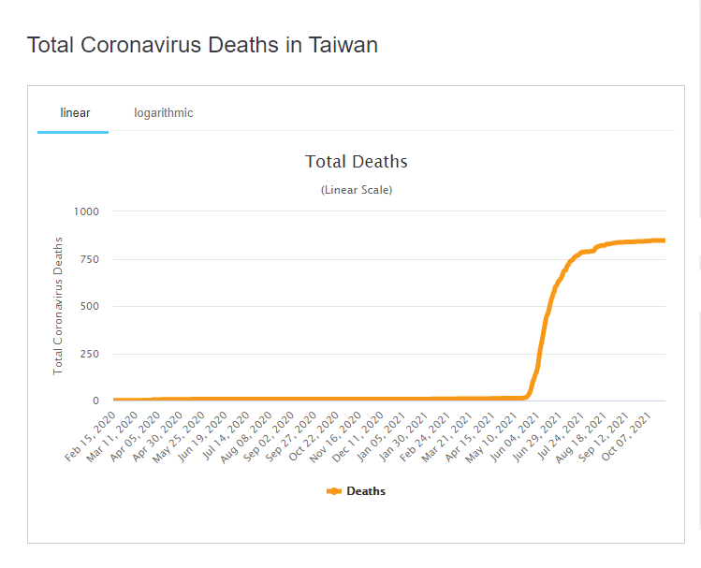
Data in the USA:
https://www.kaggle.com/sudalairajkumar/covid19-in-usa/version/102?select=us_states_covid19_daily.csv
Data in Taiwan:
https://ourworldindata.org/coronavirus/country/taiwan

Slide 7
Training Model

Slide 8
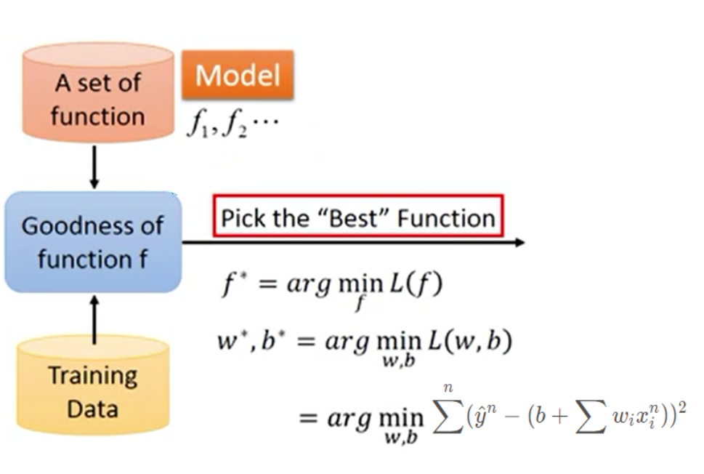

Linear Regression
How to pick n?

Slide 9
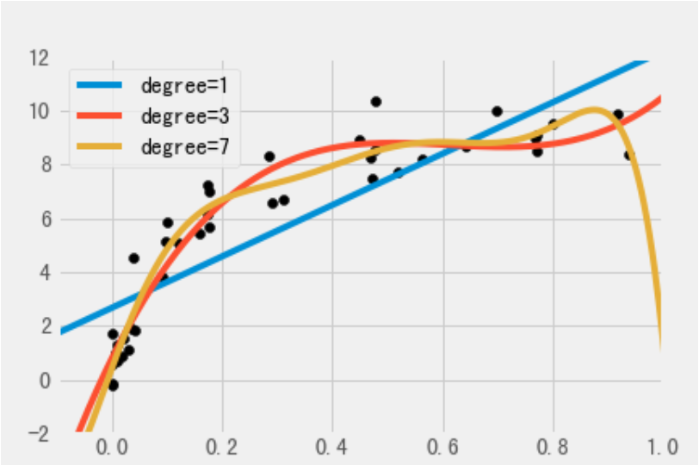
Linear Regression
How to pick n?
Make Cross Validation
Calculate the mean squared error between different degrees.
Find the smallest mean squares error.
Fit the degree to our model.

Slide 10
Visualize

Slide 11
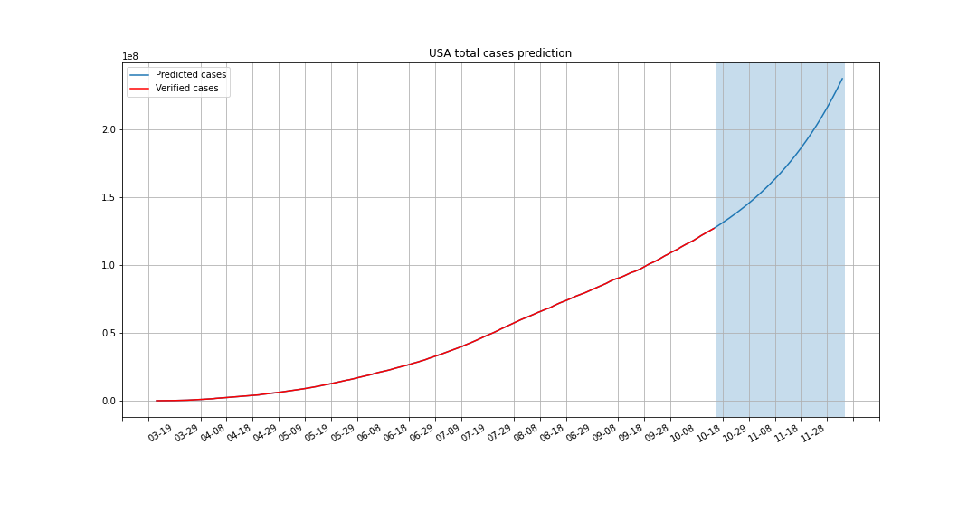
Total Cases in the USA
#Data cases: 320 days
#Prediction: 50 days
Average relative error: 0.052209

Slide 12
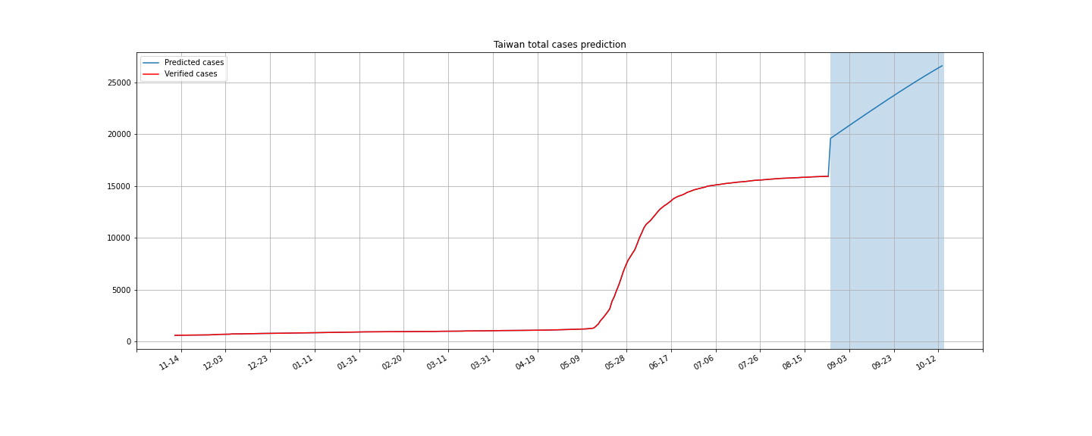
Total Cases in Taiwan
#Data cases: 640 days
#Prediction: 50 days
Average relative error: 0.501882

Slide 13
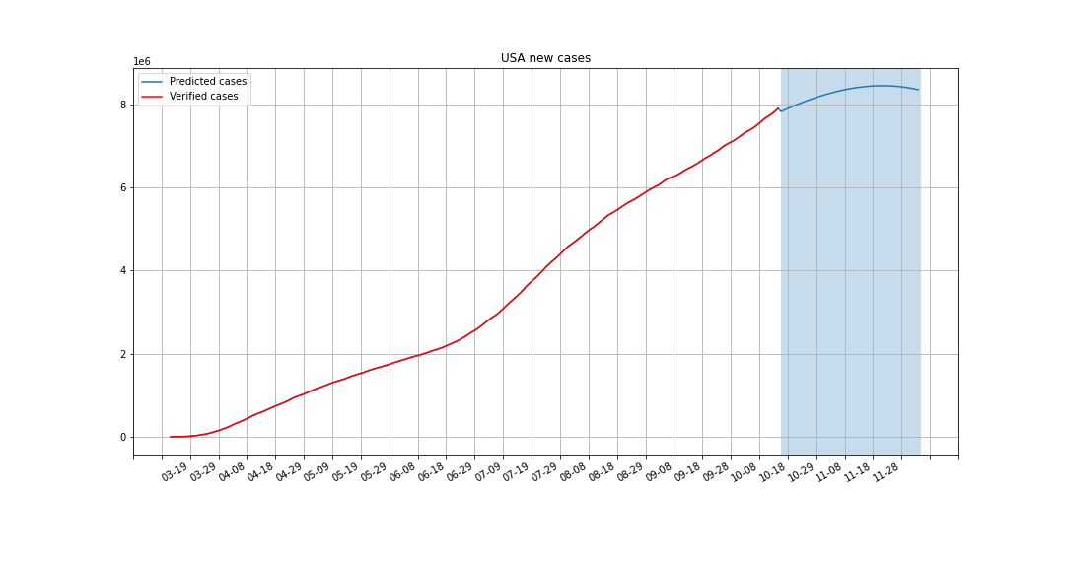
New Cases in the USA
Average relative error: 0.195231

Slide 14
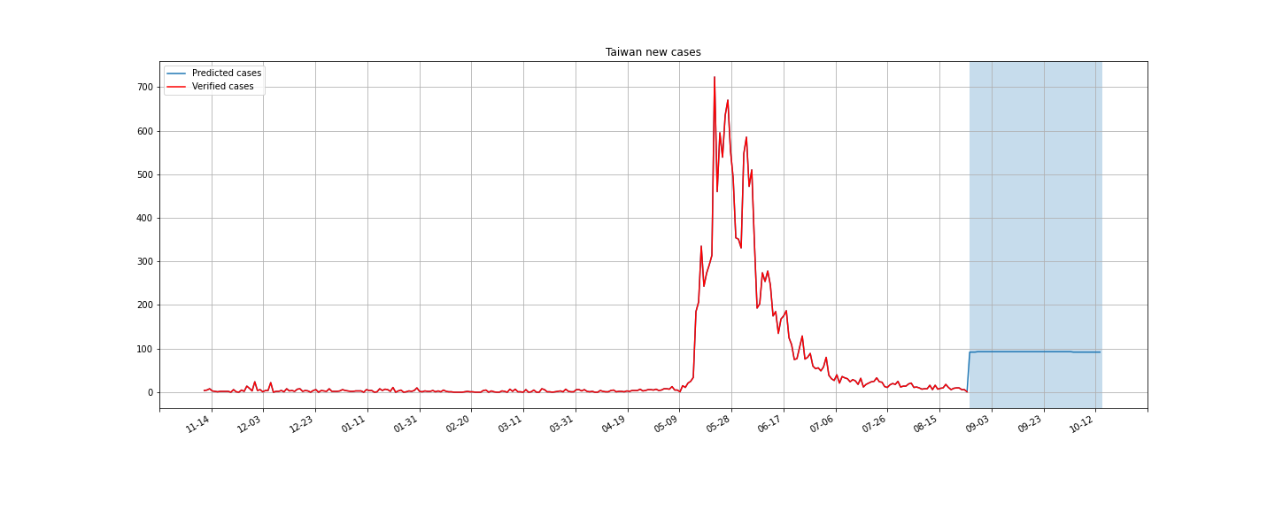
New Cases in Taiwan
Average relative error: 17.599996

Slide 15
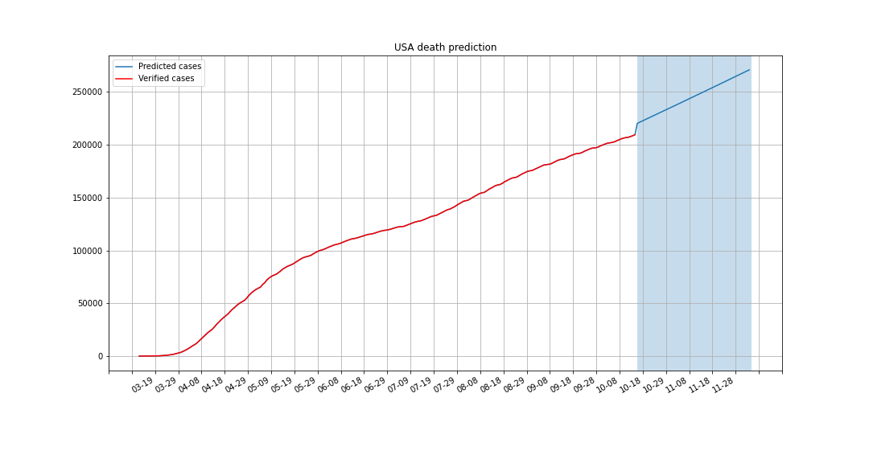
Deaths in the USA
Average relative error: 0.036151

Slide 16
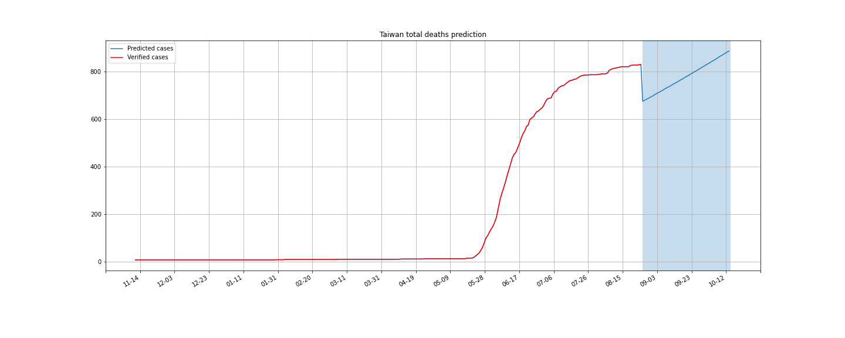
Deaths in Taiwan
Average relative error: 0.076190

Slide 17
Conclusion

Slide 18
Why Linear Regression
A long-established statistical procedure.
The properties of linear-regression models are well understood and can be trained very quickly.
Linear prediction refers to the use of observed variables to predict the dependent variable.
https://www.ncbi.nlm.nih.gov/pmc/articles/PMC7395225/
PMCID: PMC7395225

Slide 19
Drawback
Not suitable for predicting daily increase.
Depend heavily on previous prediction’s parameters.
When it encounters a big burst, it will be distortion.

